Slide 1
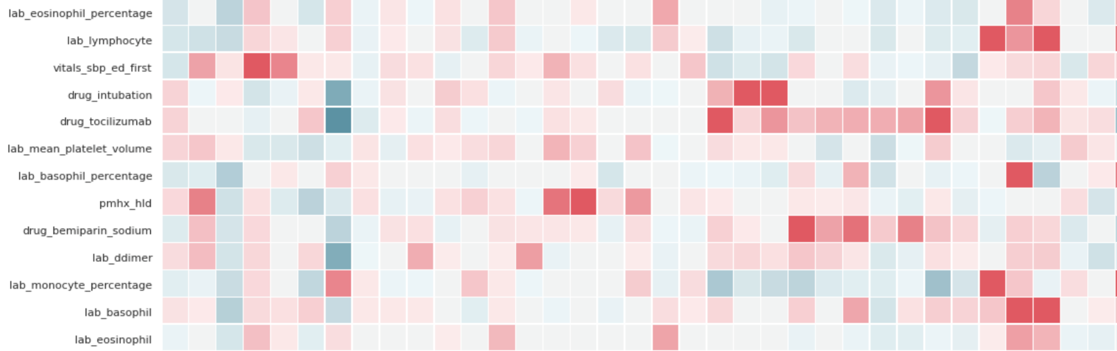
Assignment 2
COVID-19 30-day Mortality Prediction

Slide 2
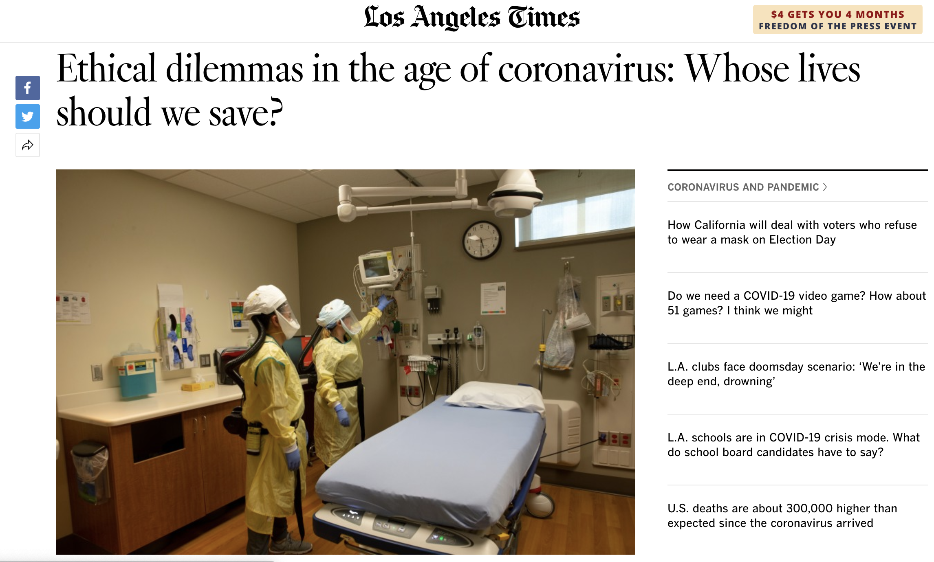
Three patients — a 16-year-old boy with diabetes, a 25-year-old mother and a 75-year-old grandfather — are crammed into a hospital triage tent and struggling to breathe. Only one ventilator is left. Who gets it?

Slide 3
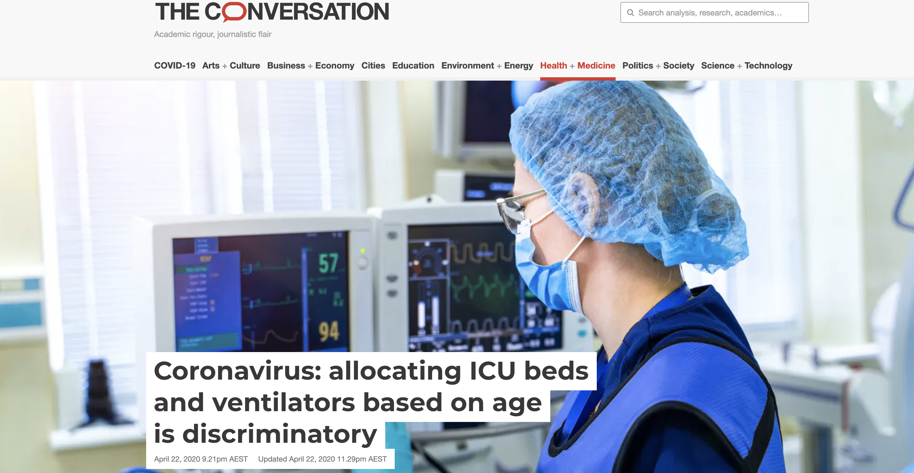
Do we have a better guideline?

Slide 4
Goal
To build a machine learning model to predict the 30-day mortality of patients
That is, whether a patient will die in the hospital within 30 days
To extract features and preprocess the data (e.g., missing data) for classification model training

Slide 5
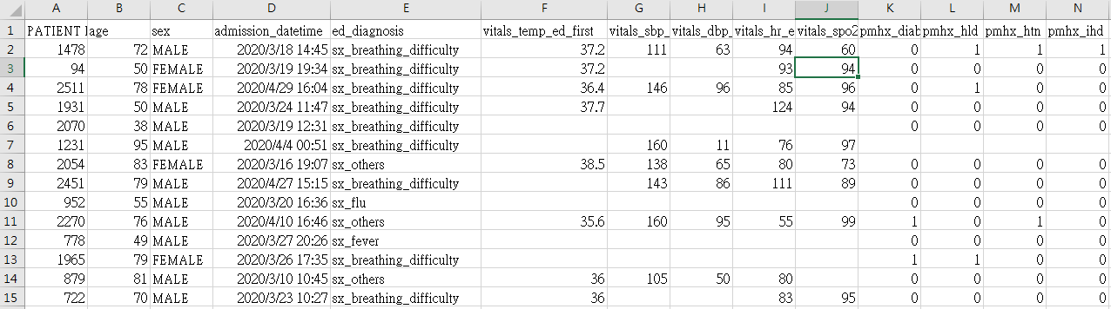
Specific Aim
To predict the future of the patient
Alive or expired ?
Part of Dataset :

Slide 6
About Training Dataset
Please keep the data confidential!
There are 1,834 patients in the training dataset and each with a unique ID and 47 attributes.
The dimensionality of the data is 1,834 *48
1,834 hospital outcome for all patients will be provided and used as the labels.

Slide 7
Data description
age | age on admission
sex | sex
admission_datetime | date of admission
ed_diagnosis | primary symptom
mechvent_fla | indicator for mechanical ventilation
vitals_temp_ed_first | body temperature at ED triage
vitals_sbp_ed_first | systolic blood pressure at ED triage
vitals_dbp_ed_first | diastolic blood pressure at ED triage
vitals_hr_ed_first | heart rate at ED triage
vitals_spo2_ed_first | SpO2 at ED triage
lab_sodium | serum sodium
lab_leukocyte | leukocyte count
lab_mean_platelet_volume | mean platelet volume
lab_neutrophil | neutrophil count
lab_alt | serum alanine aminostransferase
lab_ddimer | serum d-dimer
lab_inr | international normalized ratio
lab_mch | serum mean corpuscular hemoglobin
lab_creatinine | serum creatinine
lab_mcv | mean corpuscular volume
lab_aptt | activated partial thromboplastin time
lab_platelet | platelet count
lab_lymphocyte_percentage | lymphocyte percentage
lab_glucose | serum glucose
lab_neutrophil_percentage | neutrophil percentage
lab_ldh | lactate dehydrogenase
lab_prothrombin_activity | prothrombin activity
lab_urea | serum urea
lab_lymphocyte | lymphocyte count
lab_crp | serum c-reative protein
lab_rdw | red blood cell distribution width
lab_hemoglobin | serum hemoglobin
lab_rbc | red blood cell count
lab_hct | serum hematocrit
lab_potassium | serum potassium
lab_ast | serum aspartate aminotransferase
pmhx_diabetes | indicator for comorbidity: diabetes
pmhx_hld | indicator for comorbidity: hyperlipidemia
pmhx_htn | indicator for comorbidity: hypertension
pmhx_ihd | indicator for comorbidity: ischemic heart disease
pmhx_ckd | indicator for comorbidity: chronic kidney disease
pmhx_copd | indicator for comorbidity: chronic obstructive pulmonary disease
pmhx_asthma | indicator for comorbidity: asthma
pmhx_activecancer | indicator for comorbidity: cancer
pmhx_chronicliver | indicator for comorbidity: chronic liver disease
pmhx_stroke | indicator for comorbidity: stroke
pmhx_chf | indicator for comorbidity: chronic heart failure
pmhx_dementia | indicator for comorbidity: dementia

Slide 8
Assignment 2
Do it individually!
Announce date: 2020/10/22
Deadline for prediction, report, and model: 2020/11/12 23:59
No score if the model is not provided.
Hand in your 3 files separately in the following format
Prediction: student ID.csv
Report: student ID_HW2_Report.pdf
Model: student ID_HW2_Model

Slide 9
Grading Policy
Item | Score
Report | 30%
Model performance | 70%

Slide 10
Grading Policy of Model (70%)
In our testing data, missing data will be imputed by median for numeric features (e.g., vital signs, laboratory values) and by most frequent value for categorical features (e.g., pmhx_xxx).
We have 612 patients in the testing dataset to evaluate your model
We will use precision and recall to measure your performance

Slide 11
Precision and Recall
Ground truth
Ground truth
N
P
N
P
TN
FN
TN
FN
N
N
Prediction
Prediction
FP
TP
FP
TP
P
P
What fraction of the predicted positive are actually positive?
What fraction of the actual positive are predicted to be positive?

Slide 12
Report (30%)
Description of the model and features you used
Discussion about the importance of the attributes (e.g., age) for classification.
Description of how to use the model file
Summarizing the works you have done

Slide 13

Let’s do it!

